Slide 1
Development Tools setup
Jim Wright
Stealth 4089

Slide 2
Parts you will need
The FRC 2019 Update package (not out yet)
RoboRio image tool
RoboRio firmware update
Java JRE installer
Cross the Road Electronics Phoenix Framework Installer
Driver Station
Eclipse Development Tool
Language specific parts

Slide 3
Documents
http://wpilib.screenstepslive.com/s/currentCS
Google ‘FRC Robot 2018 Software Install’
https://github.com/JimWright4089
https://github.com/JimWright4089/FIRSTWorkshops/tree/master/FRC/2017
https://github.com/JimWright4089/FIRSTWorkshops

Slide 4
The LABVIEW UPDATE
This is needed for every team, not just the Labview teams.
The package is different than the full Labview package, much smaller.
Still takes a long while to install.
This will include the Driver Station.
Download the package, unzip it, and then run setup.exe
One screen will ask for a serial number, you can leave this blank. It’s just for a vision library.
https://github.com/JimWright4089/FIRSTWorkshops

Slide 5
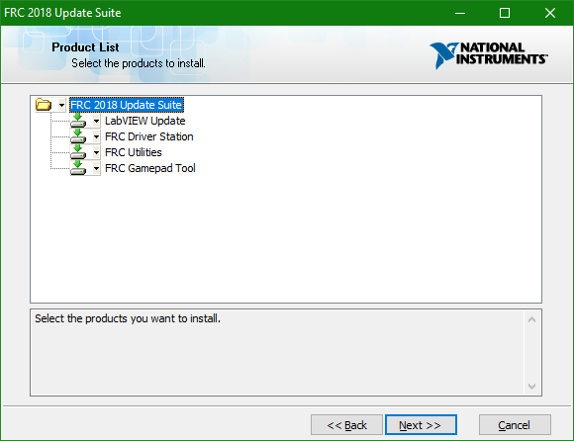
The LABVIEW UPDATE
https://github.com/JimWright4089/FIRSTWorkshops

Slide 6
TOOLS you have just added
Driverstation
Roborio imaging tool
Java JRE installer
Radio programming tool
https://github.com/JimWright4089/FIRSTWorkshops

Slide 7
Robo Rio Image TOOL
This tool puts new images onto the roborio.
It also changes the team number of the rio.
Connect this through a USB cable directly to the rio.
If updating an older rio (2017 or older) the update will be the same, but getting your program to run will take a lot more things than a simple compile. More on the CTRE update in this presentation.
https://github.com/JimWright4089/FIRSTWorkshops

Slide 8
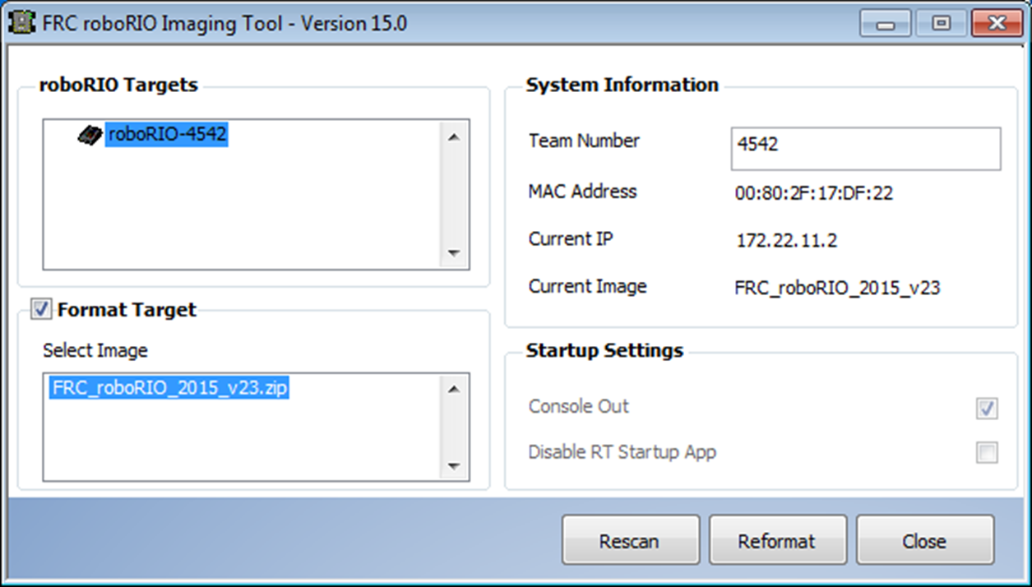
Robo Rio Image TOOL
Use this twice at least.
Once at the start of the build.
Second when you put the robot in the bag
https://github.com/JimWright4089/FIRSTWorkshops

Slide 9
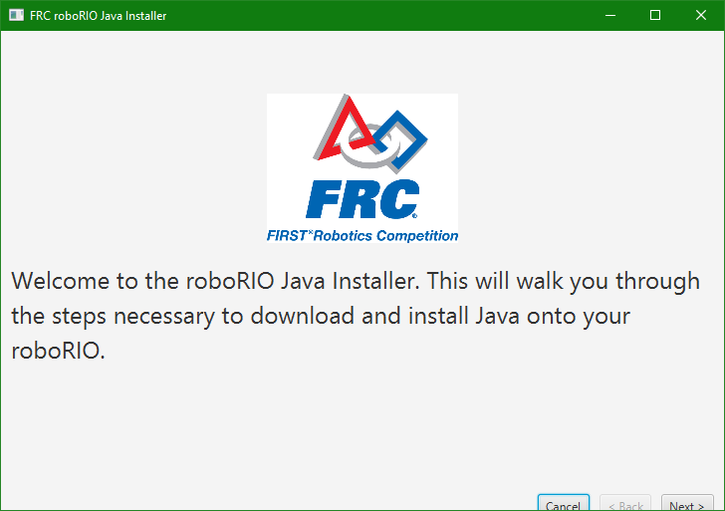
Java JRE install
It is hidden:
C:\Users\james\wpilib\tools
Put the shortcut for java-installer.jar on the desktop.
Running the first time you will need to download the JRE. There are steps in the tool for this. Once this is downloaded then the tool can read it from the last run.
https://github.com/JimWright4089/FIRSTWorkshops

Slide 10
Java JRE install
To get the JRE you will need a java account.
Which JRE to install is not very clear, however, it has not changed in a few years.
Once you have it downloaded the JRE install tool will remember it.
https://github.com/JimWright4089/FIRSTWorkshops

Slide 11
Radio Config tools
Tricky to use.
Beginning 2017 this tool would not work for several types of laptop. This has been fixed.
Radios NEED firmware. The radio NEEDS to be rebooted during the loading.
Run this tool after all of the events are over and you are showing the robot during summer.

Slide 12
Cross the road Electronics
Very important for using Talon SRXs, or Pneumatics. Minor important for other parts (the power distribution board.)
Install CTRE Phoenix Framework.
Run the Phoenix Lifeboat.
Install Phoenix/Web based tools.
Easy to forget this step.
If you are updating an old robot (2017 or older) you will have to do this as well as refactor your robot code.
https://github.com/JimWright4089/FIRSTWorkshops

Slide 13
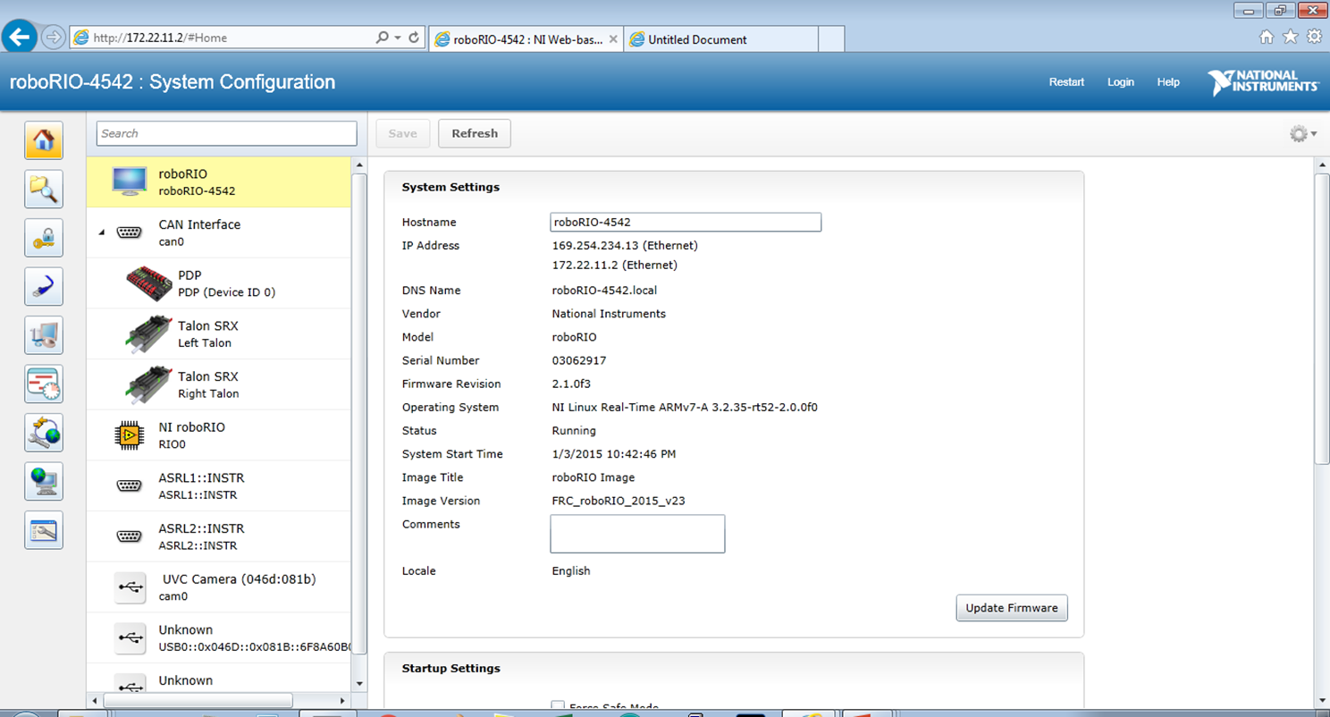
Roborio config tools
The most critical panel, and it’s the hardest to run. It needs Silverlight and most browsers don’t support it anymore.
On my Windows 10 machine I.E. is the browsers that I can only use.
Use 172.22.11.2

Slide 14
Roborio config tools
The place to update the power distribution board firmware.
Configure the Talan SRXs
Checks for IP addresses
Checks the camera is connected and working.
https://github.com/JimWright4089/FIRSTWorkshops

Slide 15
Roborio config tools
The place to update the power distribution board firmware.
Configure the Talan SRXs
Checks for IP addresses
Checks the camera is connected and working.
https://github.com/JimWright4089/FIRSTWorkshops

Slide 16
Roborio config tools
Duplicate addresses.
Pull the Power Distribution Breakers on all but one of the devices.
Set that address, then put a breaker back in to set the next.
Another trick, keep the breakers in, set the address of an item, don’t save, select another item. This tends to work but it’s tricky.
https://github.com/JimWright4089/FIRSTWorkshops

Slide 17
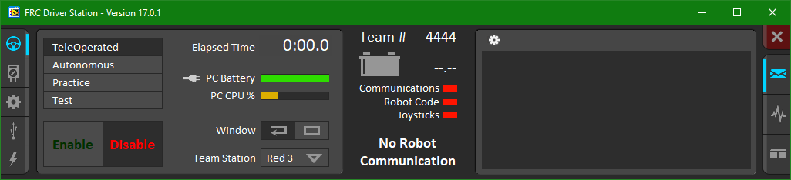
Driver station
You will use this in testing and during the events. The left icons are used to set the team number. Robot Inspectors are going to use the second icon down to find version numbers.
The USB panel configures controllers
https://github.com/JimWright4089/FIRSTWorkshops

Slide 18
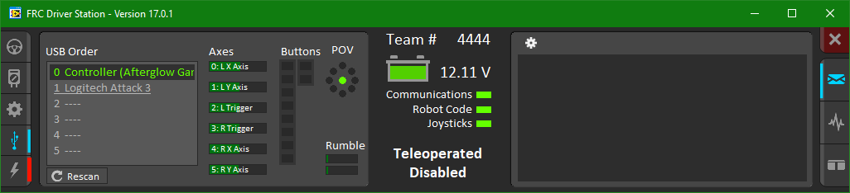
Driver station
Joystick config tool will help you find out the raw axes number. The buttons are also in order.
https://github.com/JimWright4089/FIRSTWorkshops

Slide 19
Driver station
The console and logs can be found here.
https://github.com/JimWright4089/FIRSTWorkshops

Slide 20
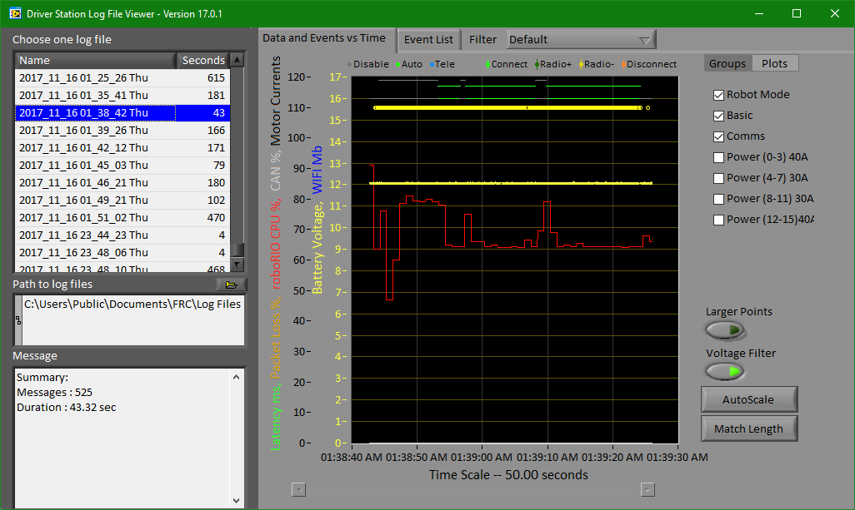
Driver station
Log file
https://github.com/JimWright4089/FIRSTWorkshops

Slide 21
Dashboard (default)
https://github.com/JimWright4089/FIRSTWorkshops

Slide 22
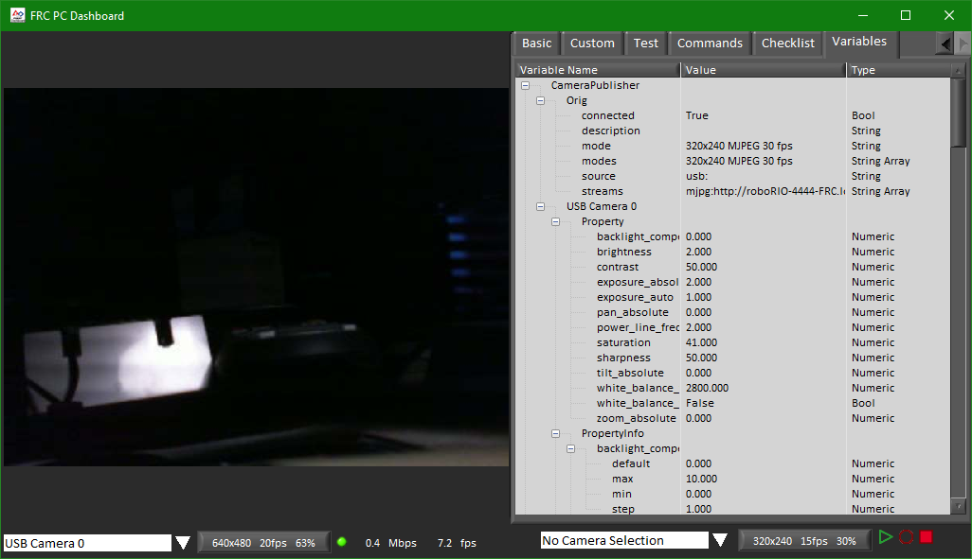
Dashboard (default) Network tables
https://github.com/JimWright4089/FIRSTWorkshops

